Slide 1
Is there a Pill that Can Delay Aging?
Stephen B. Kritchevsky, PhD
The Sticht Center on Aging

Slide 2
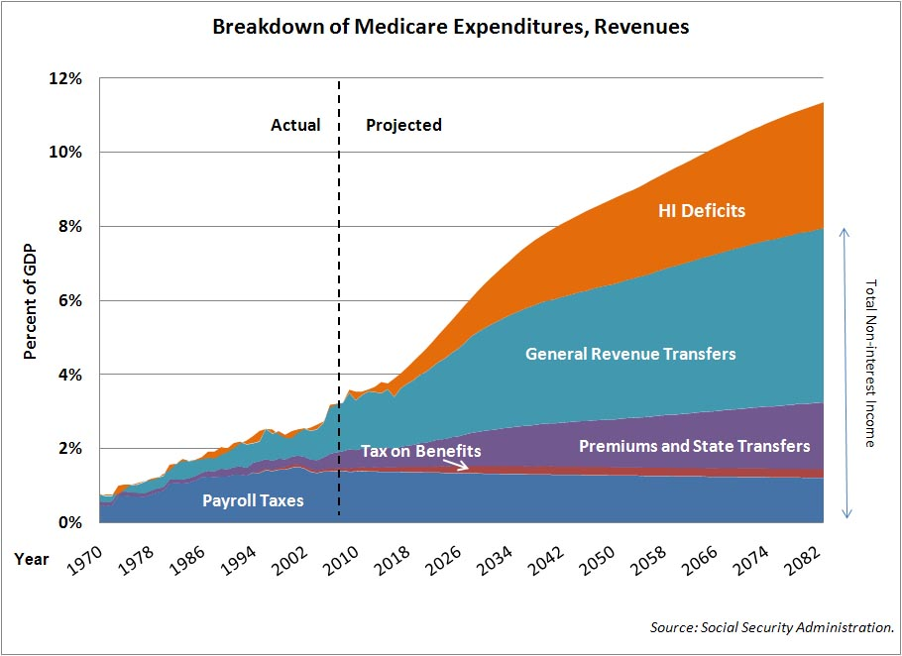
Projected Increases in Medicare Expenditures

Slide 3
Age Itself is the Strongest Risk Factor
for Age-Related Diseases
100000
10000
Heart disease
1000
Cancer
Stroke
Deaths per 100,000 per year
100
Emphysema
Pneumonia
10
Diabetes
Accidents
1
Kidney disease
Alzheimer’s
0
15-24
25-34
35-44
45-54
55-64
65-74
75-84
85+
Notes:
Slide had 2 titles before, I removed one to simplify…

Slide 4
Strategies for an Aging Society
CURRENT
Delay a specific disease through controlling specific risk factors
Good for the one disease
BETTER
Delay aging
by targeting basic molecular processes of aging
Delay multiple age related diseases
Notes:
Aging here to stay and circular

Slide 5
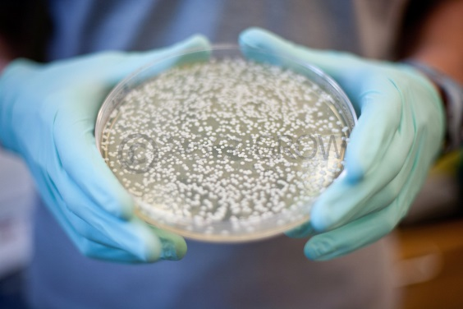
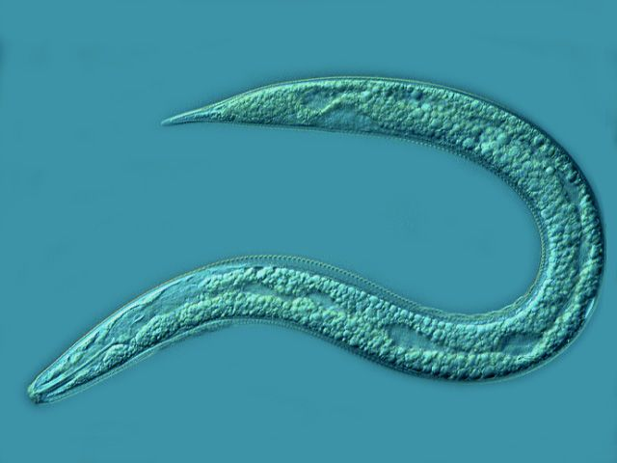
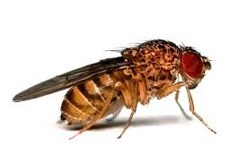
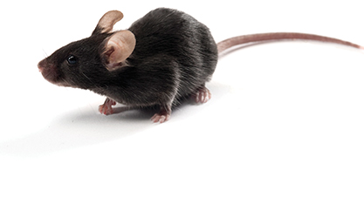
What Do These Have in Common?
Nemotode
Fruitfly
Yeast
Identify long lived individuals / species
Tease out the underlying biological pathways that explain longevity
Find chemical compounds (drugs) that target these pathways
Does giving these compounds to animals lead to increased life span?
Mouse

Slide 6
Interventions Testing Program Successes
Compound | Current Use | Life Span Gains
Aspirin | Pain Relief | 8% gain – males No gain - females
Acarbose | Diabetes Treatment | 22% gain – males 5% gain – females
NDGA | Skin ailments (topical) | 8-10% gain – males No gain – females
17-α-estradiol | Hair loss (topical) | 12% gain – males No gain - females
Rapamycin | Immunosuppressant / Immune Modulator | 23% gain – males 27% gain - females
Some failures: Resveratrol, Simvastatin, Curcumin

Slide 7
Strategies for Testing ‘Anti-Aging’ Drugs
Change in
Cellular Gene
Expression
Changes
In Mortality Assoc.
Biomarkers
Retard Emergence
Of Age-Related
Disease
Extend
Life Span
Change in
Cellular
Physiology
Slow Age-Related
Physiologic
Degeneration
Lower Mortality
Rate
FDA Interest
Time
Expense
Salience

Slide 8
Targeting Aging with Metformin (TAME)
A study to prevent the emergence of age-related disease
Executive Committee: Nir Barzilai, Jill Crandall, Mark Espeland, Stephen Kritchevsky

Slide 9
Why Metformin?
It modulates critical pathways in the biology of aging so it can be used to target aging to delay or prevent disease
It has been used safely for over 60 years
It is available as generic drug and is inexpensive.
Human data suggests broad anti-disease effects.
Disease | Strength of association
Prevention of type 2 diabetes | ++++
Prevention of CVD | +++
Prevention of cancer | ++ (largely observational)
Prevention of dementia | + / - (little data)
Reduction in mortality | +++

Slide 11
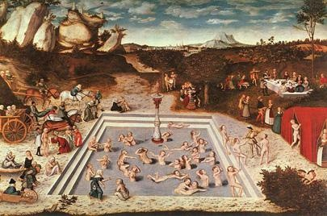
"Fountain of Youth" Lucas Cranach the Elder, (1546)

