Slide 1


Slide 2

Who are we?
What are the numbers?
What are we doing?

Slide 3
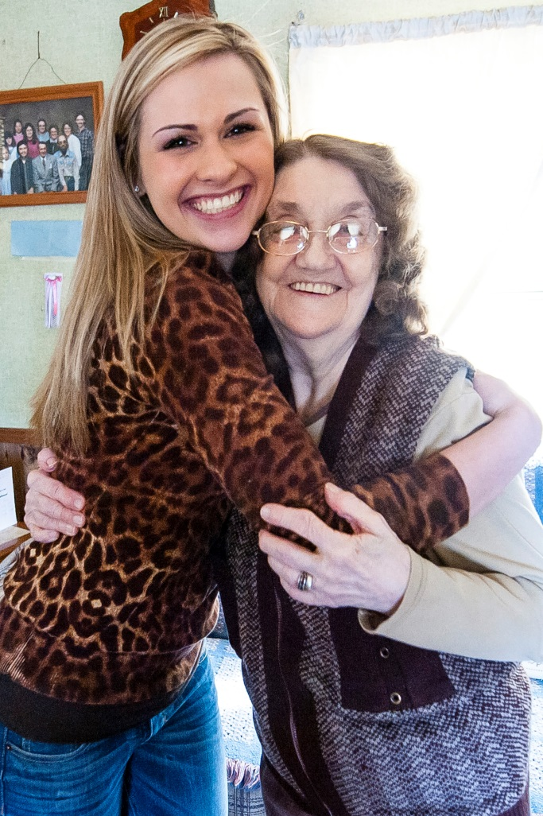
Private, nonprofit agency serving seniors in Forsyth County
2,200 volunteers, 115 staff , 65 board members, 3,700+ donors, 1,550 Elder care partners served
7 programs: Williams Adult Day Center, Help Line, Meals-on-Wheels, Home Care, Group Lunches, Living at Home and Corporate Elder Care
$6,000,000+ budget

Slide 4
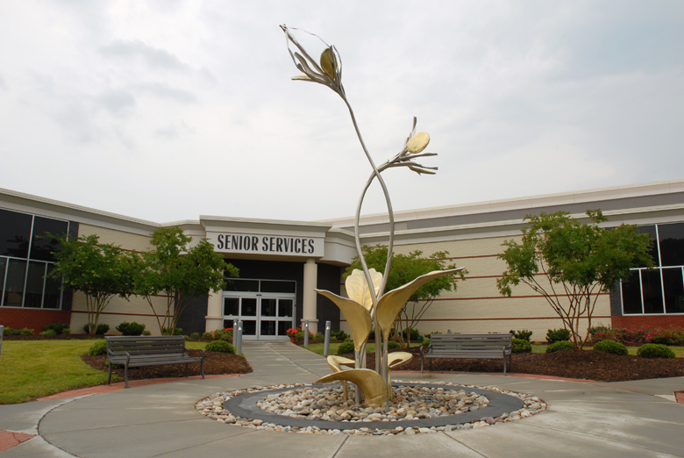
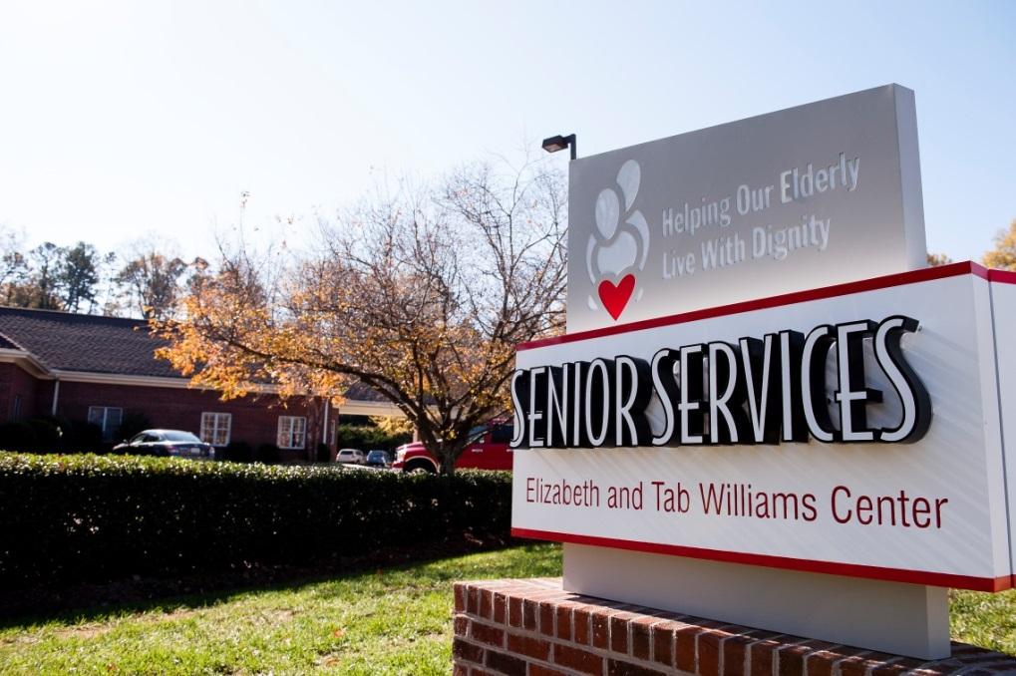
Two Locations
2895 Shorefair Drive
231 Melrose Street

Slide 5

The handwriting is on the wall!

Slide 6
Baby Boomers will turn 65 every day until 2030
10,000

Slide 7
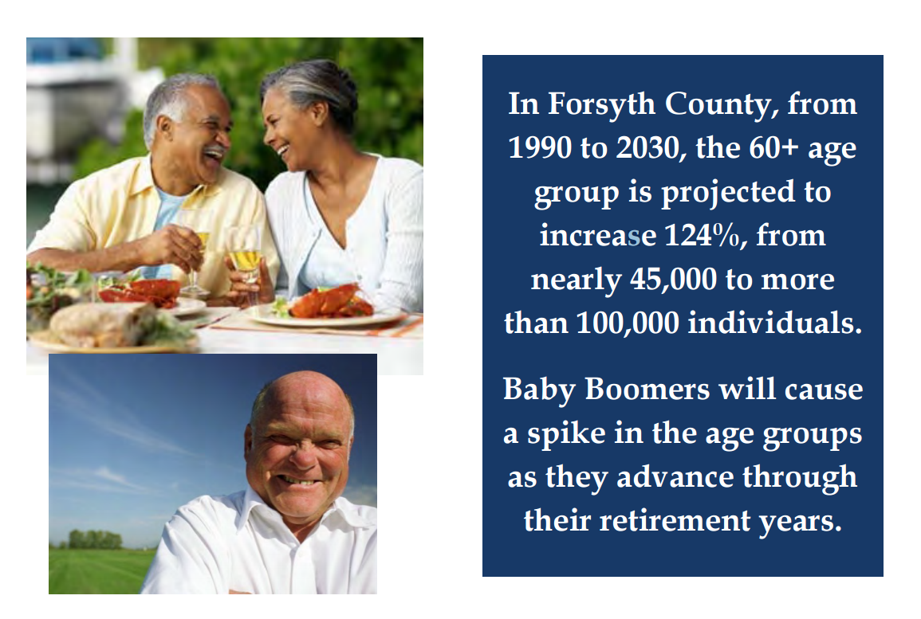
Forsyth County is getting older…

Slide 8
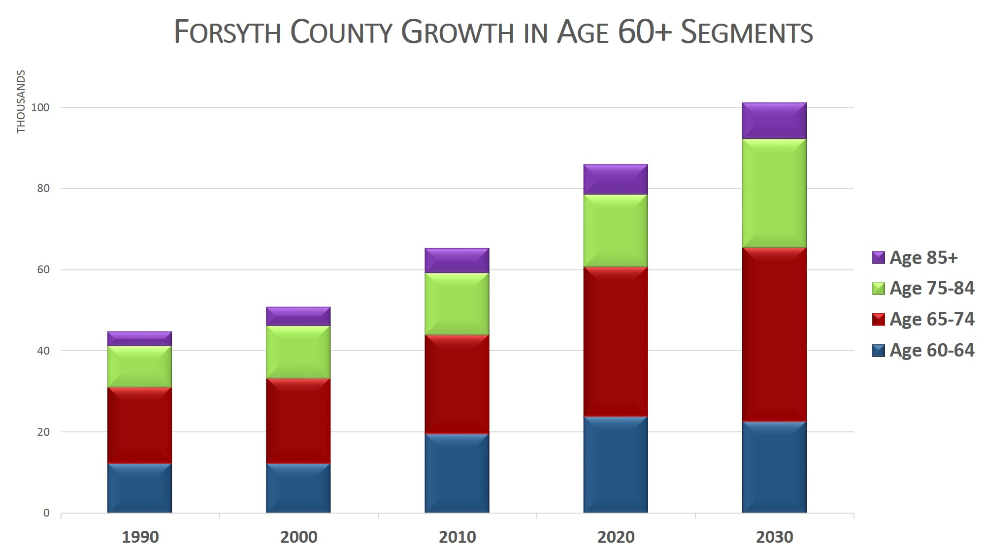
Forsyth County is getting older…

Slide 9
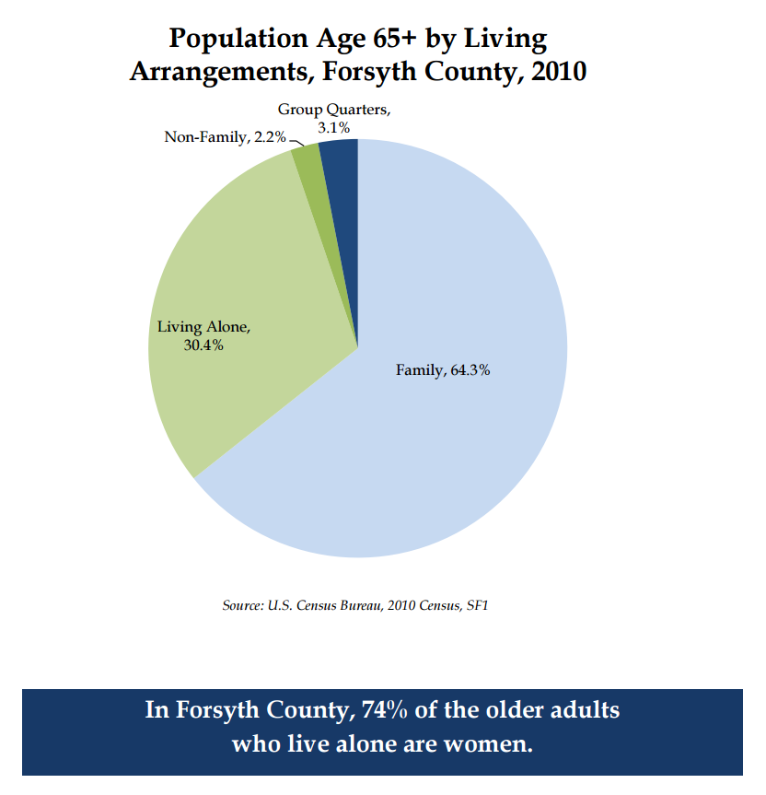
Where People Live

Slide 10
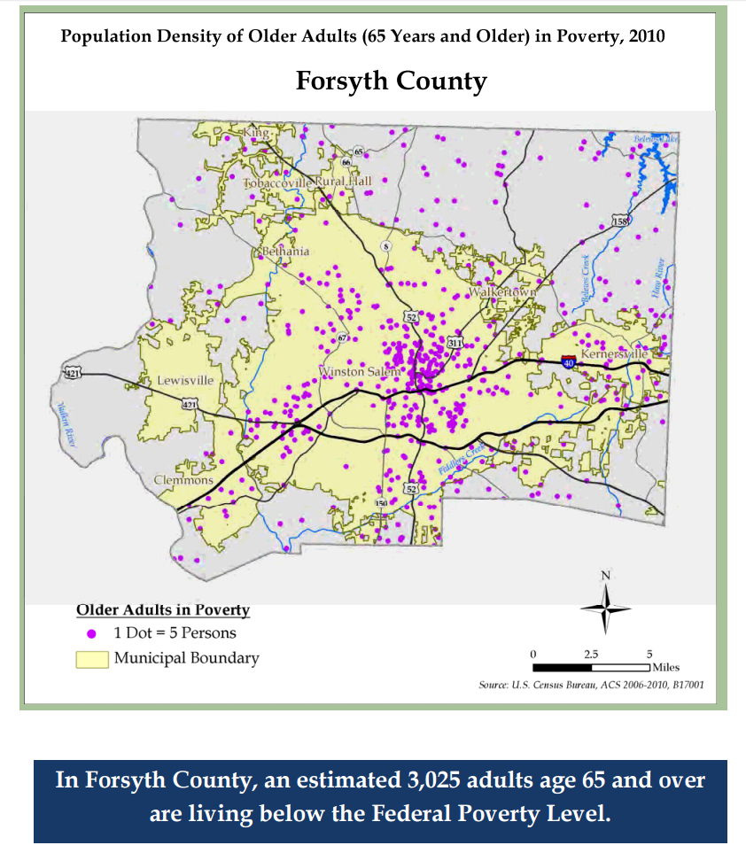
Poverty
Notes:
($11,670/15,730)

Slide 11
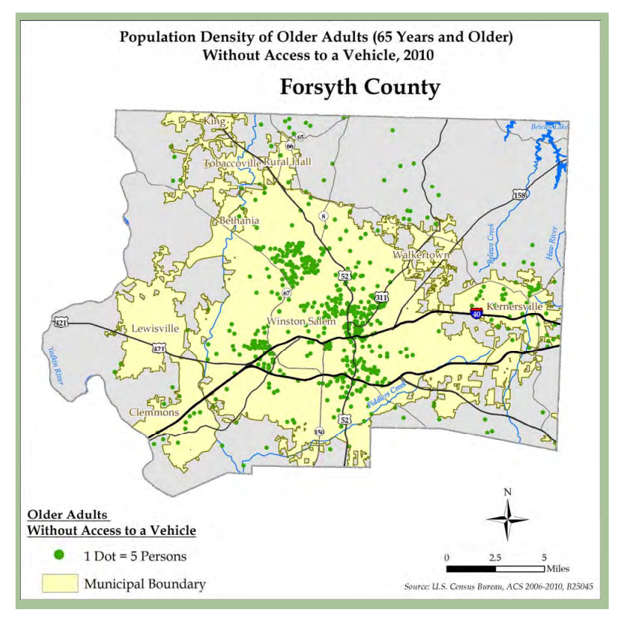
Access to Transportation
Over 3,000 households with a person 65+ do not have a vehicle

Slide 12
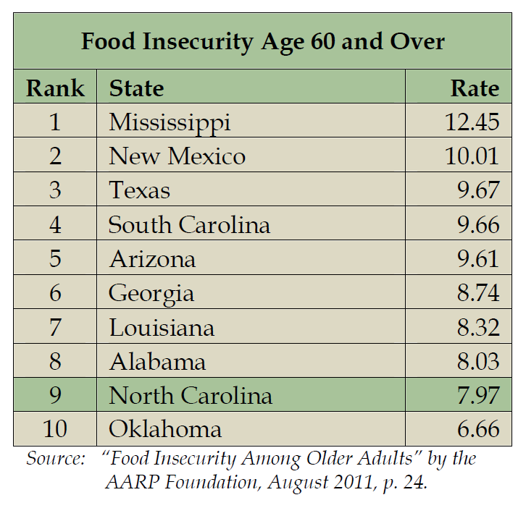
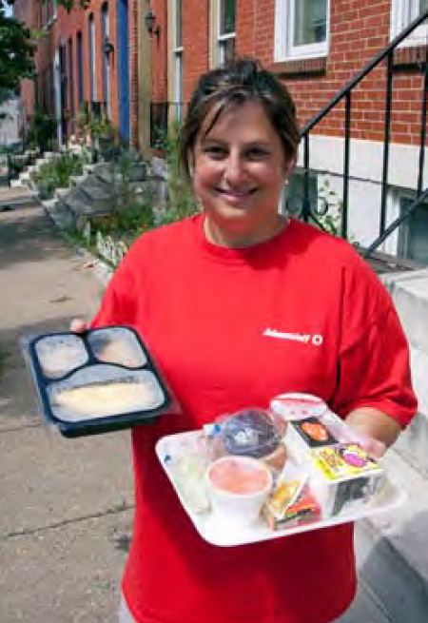
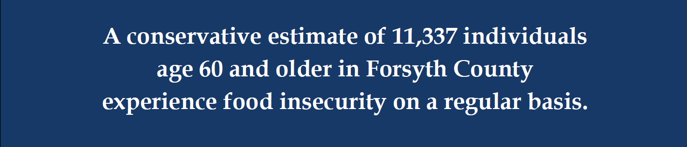
Food Insecurity
Compared to food secure seniors, food insecure seniors are
    Much more likely to have major health concerns and need assistance in their Activities of Daily Living (ADLs), such as eating, dressing, and bathing, that individuals typically can perform independently.
Notes:
Meanwhile, < 10% of older people requiring care live in a nursing home, nationally. 3% in Forsyth County

Slide 13
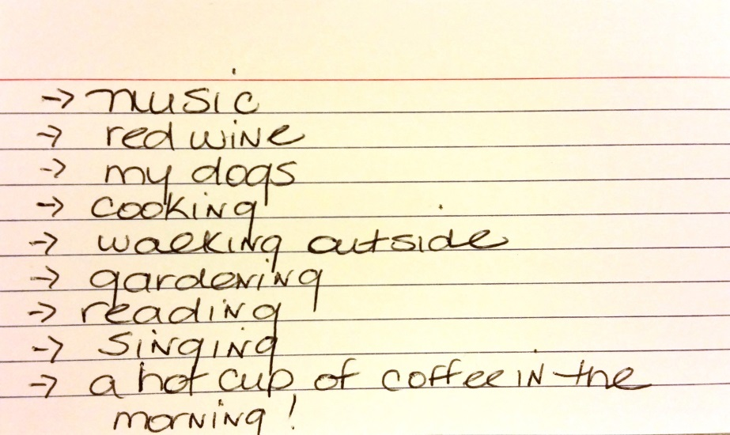
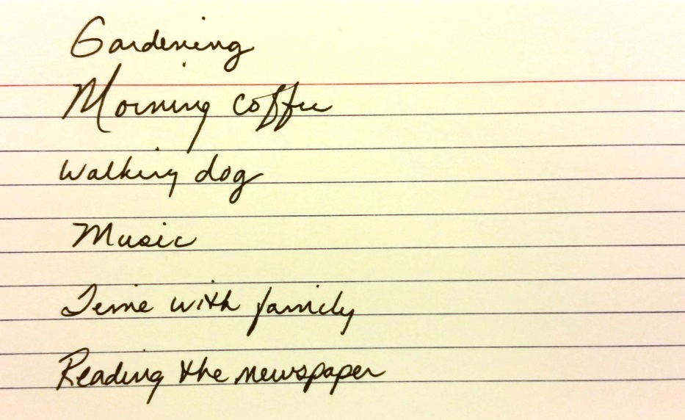
Simple Pleasures

Slide 14
Notes:
How do those daunting statistics impact even the most frail and socially isolated Elders and what can we, as an organization do about it outside of our very effective programs???? How does one end up with the 3 plagues? Ageism. Societal messages lead to feelings of low self-worth, traditional model creates helplessness, isolation creates loneliness and boredom.

Slide 15
Aging with Purpose
Why now?
  Only 3% of Elders in Forsyth County live in a facility
  Folks want to stay at home
  Impact the daunting statistics/create better health outcomes
  Reintegrate Elders back into their community – “Aging in Community”
  Prepare our community to embrace Elderhood as a key part of the lifecycle
  Combat Ageism
  It’s the right thing to do!

Slide 16
Aging with Purpose Principles
The three plagues of loneliness, helplessness, and boredom account for much suffering among Elders.
  The Eden Alternative® philosophy
Meaningless activity corrodes the human spirit. The opportunity to do things that we find meaningful is essential to human health.
  The Eden Alternative® philosophy
Reduce social isolation and find ways for all on the care partner team to become deeply known. Loving companionship is the antidote to loneliness.
Create opportunities for Elders to give as well as receive.
Focus on a person-centered approach around caring for the whole person including physical, mental and emotional needs.
Notes:
How do those daunting statistics impact even the most frail and socially isolated Elders and what can we, as an organization do about it outside of our very effective programs???? How does one end up with the 3 plagues? Ageism. Societal messages lead to feelings of low self-worth, traditional model creates helplessness, isolation creates loneliness and boredom.

Slide 17
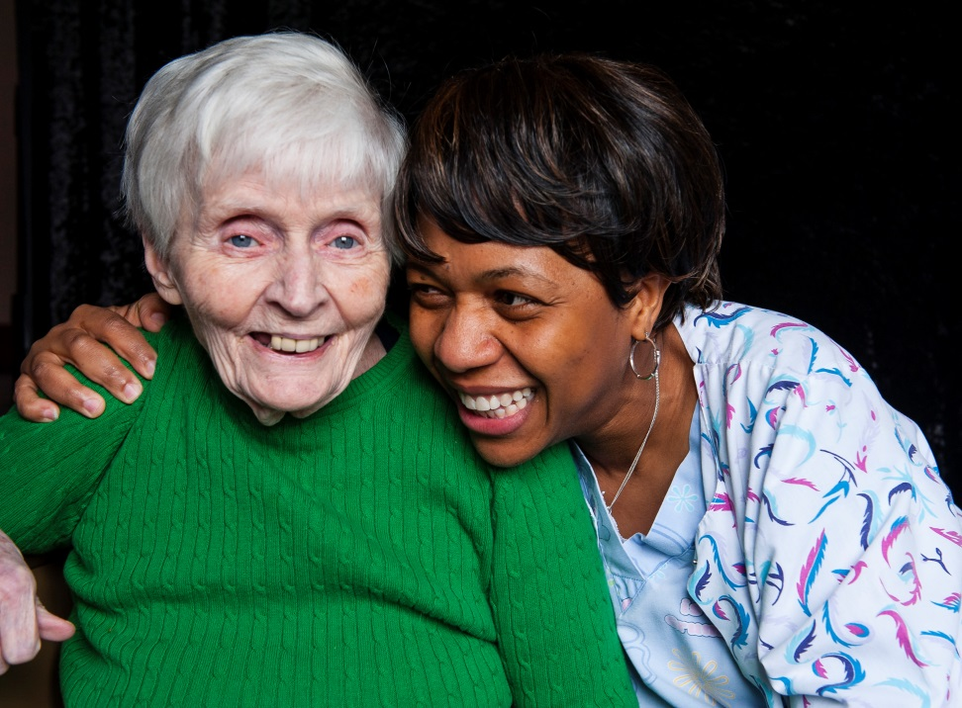
Steps in Aging with Purpose Pilot
1.) Gather “Life Stories” of pilot group of Elders and inventory their abilities and goals
2.) Create opportunities to build relationships and reduce social isolation
3.) Discover opportunities for meaningful activity – chance to give as well as receive
4.) Measure outcomes
Notes:
Take the Eden

Slide 18
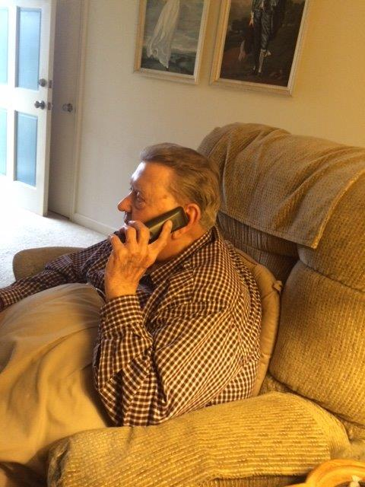
Living History
Licensed story-gathering program typically used in hospital or long term care settings to improve patient satisfaction
  First community-based agency to utilize it
  Open-ended interviews help us discover who our Elders really are – not deficiency based
  Discover gifts, abilities and what matters to them
Notes:
Give example of Warren K and Mattie Mae and how we are creating relationships and meaning for them Asset-based

Slide 19
Founded by Dr. Bill Thomas in upstate NY over 20 years ago in a nursing home setting where Elders were suffering from the three plagues of loneliness, helplessness and boredom
Driven by a ten-principle philosophy that reconnects Elders to their communities
De-emphasizes traditional model of care and embraces person-directed care
Creates opportunities for Elders to give as well as receive.
Notes:
1st principle - The three plagues of loneliness, helplessness, and boredom account for much suffering among Elders. Give some detail about his experience in the NH.

Slide 20
Systemic Culture change
  20 trained Eden at Home Associates in the Community
  Agency-wide trainings
Change in Language
  “Elderhood”
  Care Partner Teams
  Elder Care Partner
  Definition of “Care”
Being well-known
Notes:
Discuss language and culture change – Elderhood, Eldercare Partner, Care Partner Teams
Tools – Stories, being well-known, - Living History

Slide 21
Aging with Purpose Pilot Summary
Eden-trained staff and volunteers
Living Histories
Validated outcome measures including quality of life, depression, healthcare utilization, social isolation, and food insecurity.
Connection with programs or interventions based on Eldercare Partner skills and strengths.

Slide 22
Aging with Purpose Impact
Embracing Elderhood
Re-engaging Elders back into the social fabric of their community – “we need you”
Prolong good health and quality of life
Creating an aging-friendly community

Slide 23
Questions?

