Slide 1
Laura Baker, PhD
Wake Forest School of Medicine

Slide 2
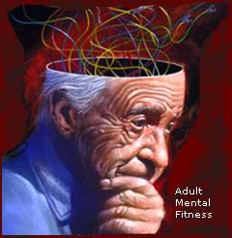
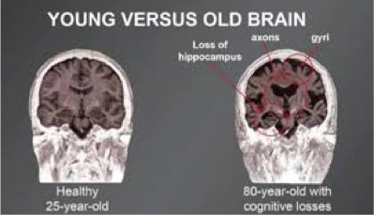

Slide 3
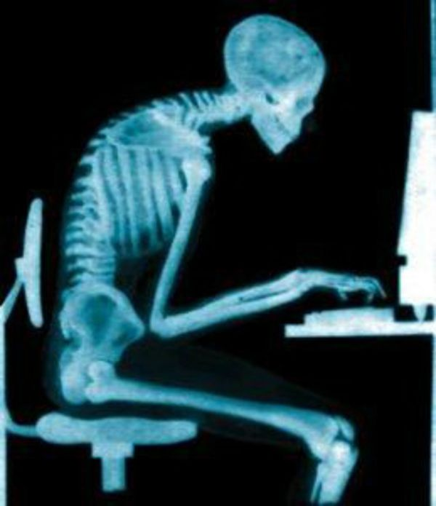
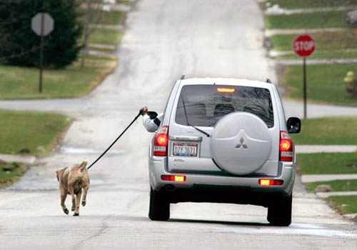

Slide 4
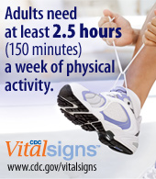
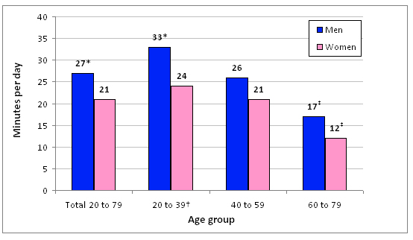

Slide 6
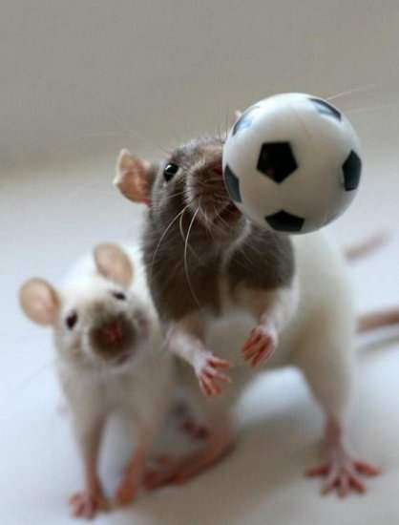

Exercise Protects Brain Function in Normal & Pathological Aging
  Animal studies:
  ++ effects on brain structure & function (neurons, inflammation, blood vessels, resilience to stress, Alzheimer pathology)
  Clinical studies:
  Growing support for ++ effects on memory & thinking in healthy older adults -&- in those with a mild memory impairment

Slide 7
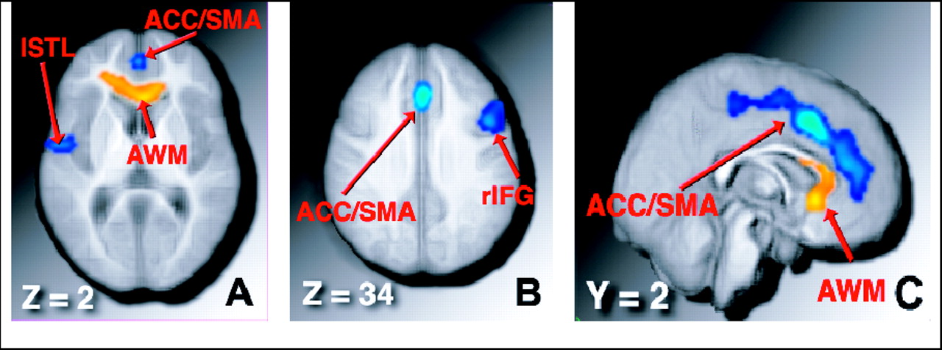
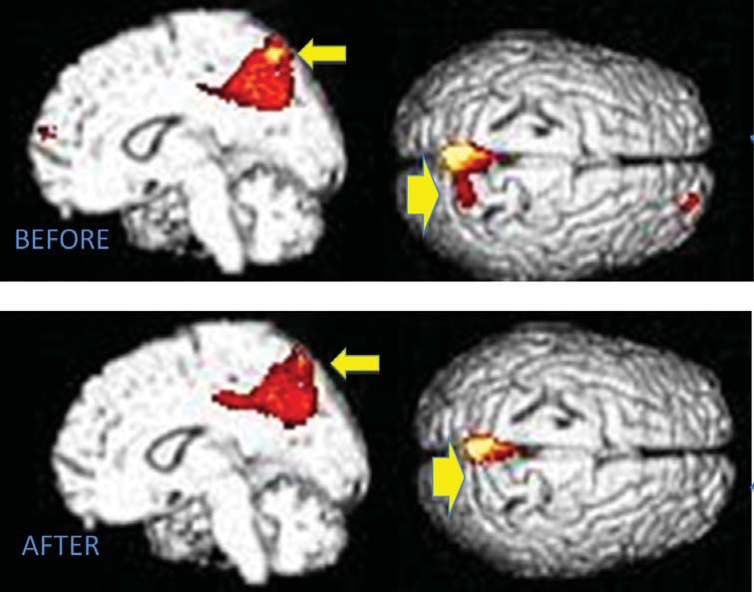
Aerobic Exercise and Brain Function in Older Adults
In healthy adults, brain volume increased with 6 months of aerobic exercise (blue=GM, orange=WM) (Colcombe 2006)
In adults at increased risk for Alzheimer’s dementia (mild cognitive impairment), exercise increased metabolic activity in regions that are compromised in the earliest stages of Alzheimer’s (Porto 2016)

Slide 8

?
Memory Loss

Slide 9
Piedmont Triad Aging, Cognition, and Exercise (PACE) Study
Can aerobic exercise restore health to the brain in adults who are at high risk for developing Alzheimer’s dementia?
WHY ?
Notes:
Can a potent insulin sensitizing intervention that slows or reverses metabolic disease also improve AD biomarkers and cognition in high risk adults with both conditions?
Positive results to support ‘exercise is medicine’ for these adults could have important implications for early identification & treatment

Slide 10
Piedmont Triad Aging, Cognition, and Exercise (PACE)
Clinic Visit to Identify High Risk Older Adults
Aerobic Training vs. Stretching Control
Month 0
Month 6
Lumbar Puncture
Brain Imaging
Cognitive Assessment
Notes:
Can a potent insulin sensitizing intervention that slows or reverses metabolic disease also improve AD biomarkers and cognition in high risk adults with both conditions?
Positive results to support ‘exercise is medicine’ for these adults could have important implications for early identification & treatment

Slide 11

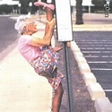
Intervention
45 min/day, 4 days/week, for 6 months at local YMCAs
1st 6 wks – gradual increase in duration & intensity
Supervised by trainer for 1st 8 sessions, 1x/week thereafter
Compliance outcomes recorded weekly by trainer
Pts complete daily activity logs & receive weekly call from staff
91% adherence (sessions completed per wk)
Target HR = 70-80% of maximum
Equipment = treadmill, stationary bike, elliptical trainer, approved classes
Target HR < 35% of maximum
Routine = series of stretching & balance exercises, gentle yoga & other approved classes

Slide 12
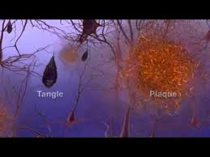
Aerobic Exercise and Biological Markers of Alzheimer Pathology in Cerebrospinal Fluid
Protein involved in a hallmark brain cell abnormality (the ‘tangle’) was reduced in adults over the age of 70
Tau Protein (pg/ml)
~ Change from Baseline ~

Slide 13

Aerobic Exercise Effects on Cognition
Executive Function: Planning, Initiation, Multi-tasking
~ Change from Baseline ~

Slide 14
Brain Regions Showing Cell Loss in the Earliest Stages of Alzheimer’s Disease
Areas of brain volume GROWTH in the aerobic exercise group

Slide 15
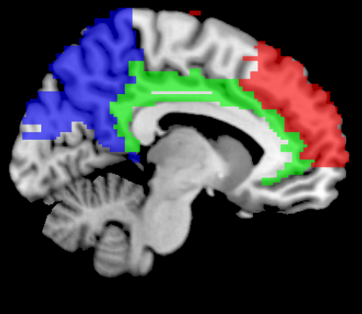
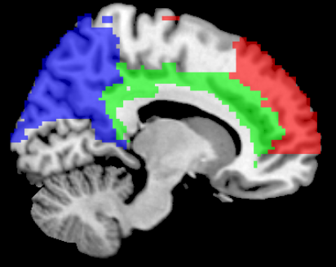
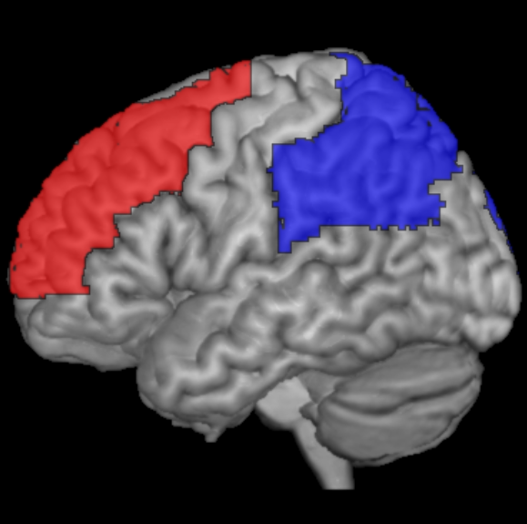
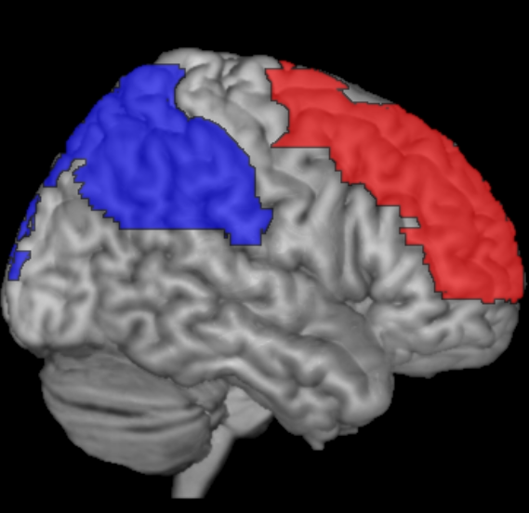
Aerobic Exercise Increases Blood Flow in Regions Compromised by Aging & AD
Right
0.09
0.03
0.01
Stretch
Aerobic
Left
0.01
0.009
0.02
* means adjusted for age, baseline BMI

Slide 16

Exercise to Protect the Brain as We Age
Is It Worth The Sweat ?

Slide 17
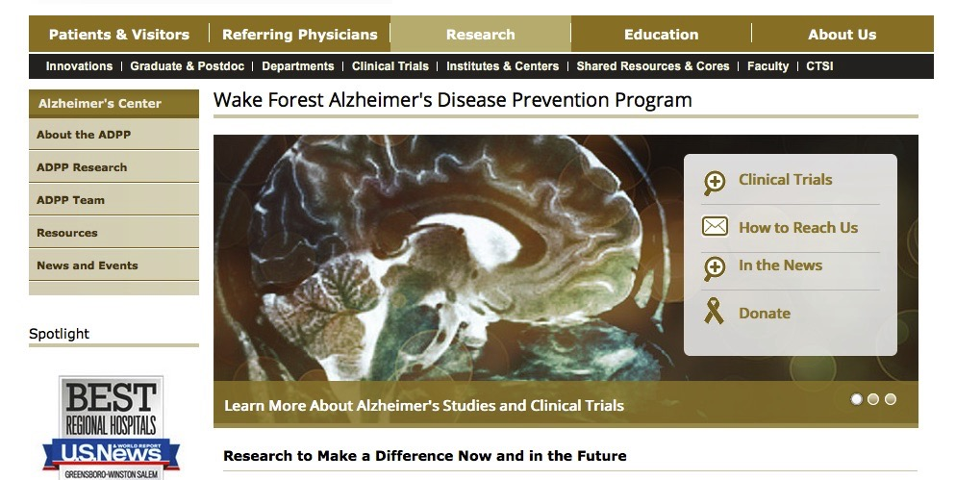
How to Find Us …
http://www.wakehealth.edu/Alzheimers/
Phone: 855-381-MIND (6463) or 336-716-MIND (6463)
Email: adc@wakehealth.edu
Address: Sticht Center on Aging, Wake Forest Baptist Medical Center, Winston Salem, NC

