Slide 1
The Women’s Health Initiative Memory Studies: How Does Postmenopausal Hormone Therapy Affect Women’s Brains?
The Women’s Health Initiative Memory Study Research Team, Wake Forest School of Medicine

Slide 2
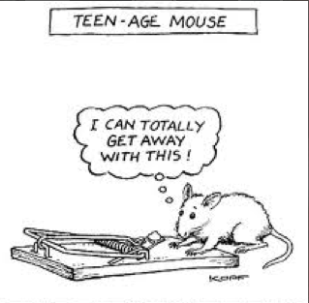

Slide 3


Slide 4






Women’s Health Initiative (WHI) Clinical Trials
(Diet, Hormones, Calcium/Vit D) and Observational Study
Conducted at 40 Clinical Centers
+ Clinical Coordinating Center
(Fred Hutchinson Cancer Research Center)
Bernadine Healy,
MD NIH
Pat Schroeder,
Congress
Ross Prentice, PhD
U Wash
Jacques Rossouw,
MD NHLBI
Marcia Stefanick
PhD, Stanford

Slide 5





Women’s Health Initiative Memory Study
Sally Shumaker, PhD
Wake Forest

Slide 6
Cumulative Hazard of Probable Dementia and Any Impairment From Time of WHI Enrollment
Probable Dementia
Any Impairment
P=0.003
P=0.008
HT
HT
Placebo
Placebo
Mean Duration of Trials:
CEE+MPA: 4.2 yrs; CEE-Alone: 5.4 yrs
Shumaker, et al. JAMA 2003;7:217-23.
Shumaker, et al. JAMA 2004;291:2947-58.
Notes:
6

Slide 7






Why is hormone therapy harmful for older women’s brains?
Susan Resnick, PhD NIA
W. Nick Bryan, MD Univ Penn
Laura Coker, PhD Wake Forest
Claudine Legault, PhD
Wake Forest
Patricia Hogan, MS
Wake Forest

Slide 8
Brain Volumes
Mean Brain Volume (cc)
P=0.03
Espeland, et al. J Gerontol A Biol Sci Med Sci 2009;64:1243-50.

Slide 9
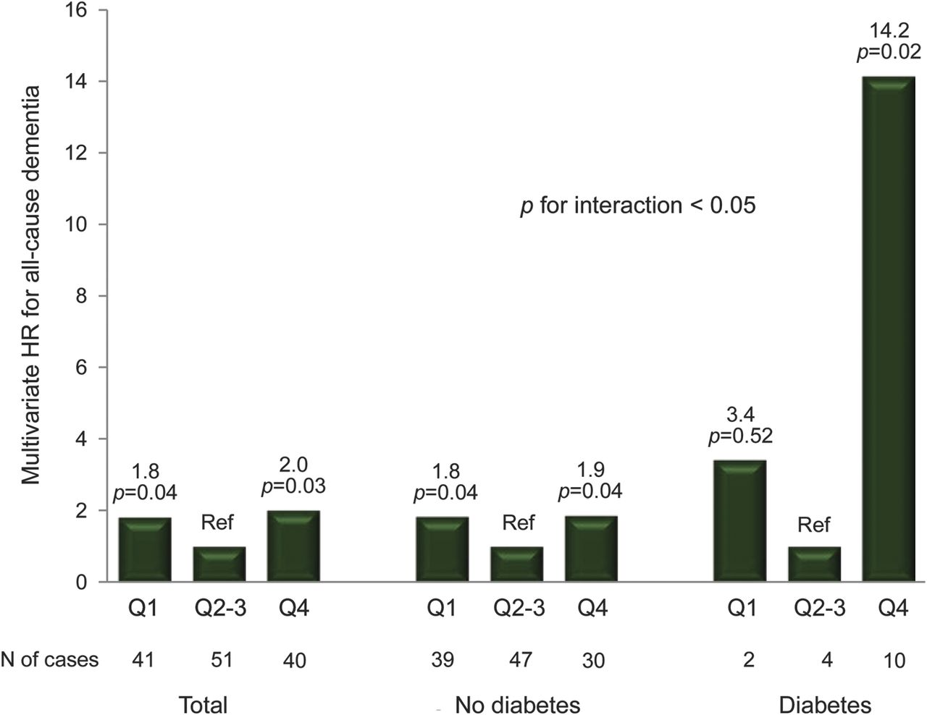

Total-E2 and all-cause dementia risk by diabetes status: Multivariate HRs for all-cause dementia associated with total-E2 levels in quartiles (Q2 and Q3 taken as the reference), by diabetes status.
Carcaillon, et al. Neurology 2014;82:504-511
© 2014 American Academy of Neurology

Slide 10




How Does Hormone Therapy Cause Loss of Brain Matter?
Roberta Brinton, PhD
USC
Kristine Yaffe, MD
UCSF
Christina Hugenschmidt, PhD, Wake Forest
Suzanne Craft, PhD
Wake Forest

Slide 11
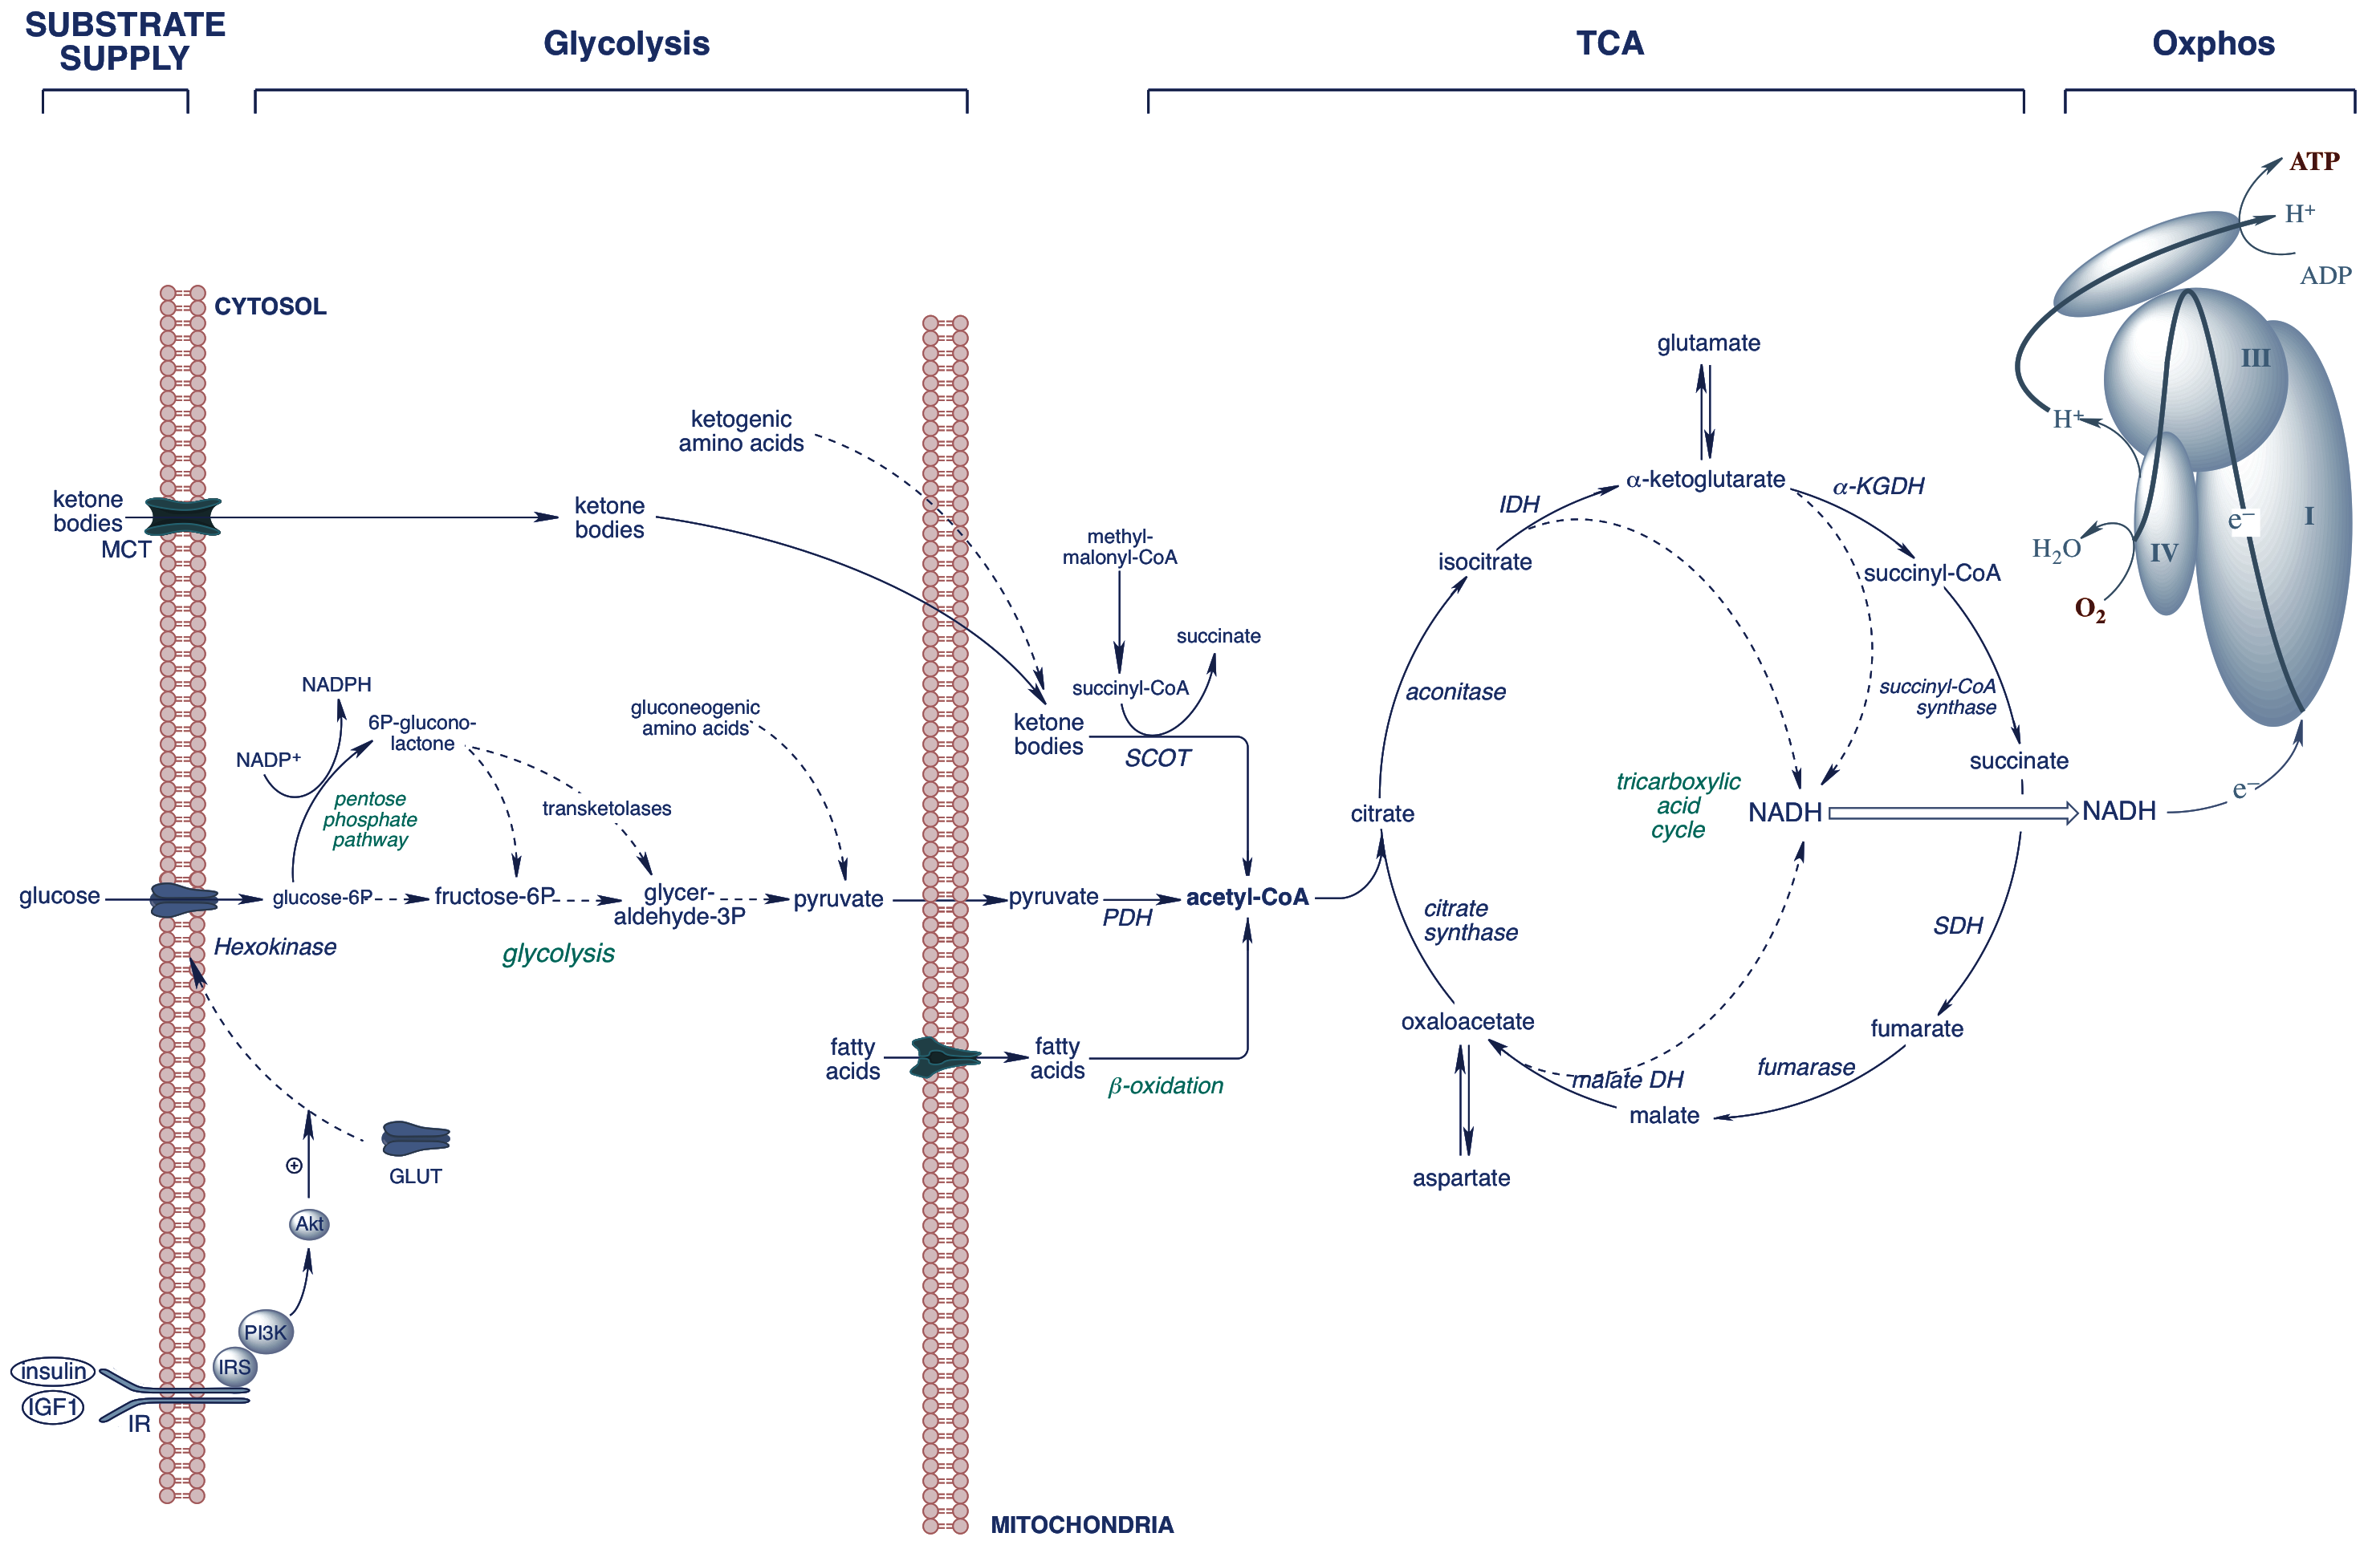
Estrogen is a Bioenergetic System Regulator of Glucose Metabolism in Brain: Promotes Glucose Metabolism & Suppresses Ketone Body Metabolism
17β-Estradiol
Nilsen et al., J Neurosci 2007; Brinton TINS 2008; TIPS 2009; Yao et al., PNAS 2009 ; Rettberg et. al., Front Neuroendo 2013
Notes:
Key enzymes: PDH, a-KGDH, complex I, IV, and V
Estrogen-Bioenergetic system molecule

Slide 12
Hormone Therapy Differentially Affects Brain Volumes and Risk of Dementia for Women With Diabetes
Brain Volume (cc)
P=0.002
Odds of Dementia
P=0.03
Diabetes
No Diabetes
Diabetes
No Diabetes
Diabetes
No Diabetes
Diabetes
No Diabetes
Espeland, et al. Diabetes Care 2015;38:2316-24.
Espeland, et al. Neurology 2015;29;85:1131-8.

Slide 13




Is Hormone Therapy Safe For Younger Women’s Brains?
JoAnn Manson, MD
Harvard
Laura Baker, PhD
Wake Forest
Kate Hayden, PhD
Wake Forest
Lifang Hou, MD
Northwestern

Slide 14
Mean Global Cognitive Function Scores
Mean TICS-M
P=0.66
Espeland, et al. JAMA Int Med 2013;73:1429-36.

Slide 15




Maintain Your Overall Health
Hypertension
Depression
Cardiovascular diseases
Karen Johnson, MD
UT-Memphis
Joseph Goveas, MD
UW-Milwaukee
Bernhard Haring, MD
Univ Minn
Leslie Vaughan
Wake Forest
Johnson, et al. J Am Geriatr Soc 2008;56:1449-58
Goveas, et al. Int Psychogeriatr 2012;3:1-13.
Haring, et al. J Am Heart Assoc 2013.
Vaughan, et al. Neuropsych Dev Cogn B 2016;23:117-31.

Slide 16




Adopt a Healthy Lifestyle
Maintain physical function
Healthy diet
Hal Atkinson, MD
Wake Forest
Jessica Agnew-Blais, ScD
Harvard
William Harris, PhD
OmegaQuant
Sylvia Wassertheil-Smoller, PhD
Albert Einstein
Atkinson, et al. J Gerontol 2010;65:300-6.
Pottala, et al. Neurology 2014;82:435-42.
Agnew-Blais, et al. J Acad Nutr Diet 2015;115:231-41.

Slide 17

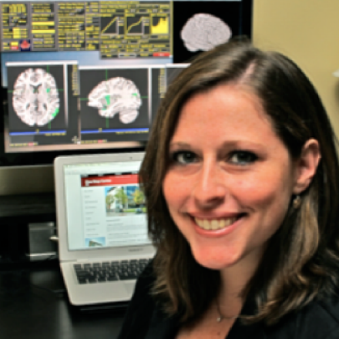

Education and Training
College education
Military training
Stephen Rapp, PhD
Wake Forest
Claudia Padula, PhD
Stanford
Julie Weitlauf, PhD
Stanford
Rapp, et al. Int J Psychiatry Med, 2013;46:121-43.
Padula, et al. Gerontologist 2016;56:115-25.

Slide 18



Take Care of the Environment
Sidewalks and parks
Air pollution
Ozone
Regina Shih, PhD
Rand Corp
Jiu-Chiuan Chen, PhD, MD
USC
Ramon Casanova, PhD
Wake Forest
Shih, et al. Am J Public Health 2011;101(9);1721-8.
Chen, et al. Ann Neurol. 2015;78:466-76.

Slide 19



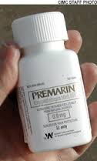
For Healthcare Professionals >
IMPORTANT SAFETY INFORMATION AND INDICATIONS
Do not use estrogens with or without progestins to prevent heart disease, heart attacks, strokes or dementia (decline in brain function).
Using estrogens, with or without progestins, may increase your chance of getting dementia, based on a study of women 65 years of age or older.

Slide 20

Women’s Health Initiative Volunteers

Slide 21


Wake Forest Alzheimer's Disease Prevention Program
Research to Make a Difference Now and in the Future
http://www.wakehealth.edu/Alzheimers/

Slide 22
QUESTIONS ?

Slide 23


WHI E+P Trial: Preliminary Findings, July 2002 (5.2yrs)
Risks
29% Increase CHD (Coronary Heart Disease)
Benefits
41% Increase
Stroke
33% Decrease Hip Fracture
Fewer Colorectal Cancers
113% Increase Pulmonary Emboli
26% Increase
Breast Cancer
Threshold Level
STOPPED Early, Clear Harm
Stopped 3.3 yrs early
* had 0.4 more yrs of data
Also: DVTs
Other Fractures
*Adapted from: Writing Group for the Women’s Health Initiative. JAMA. 2002;288:321-333

Slide 24
WHI E only Trial: Preliminary Findings, March 2004 (aver. 6.8 yrs)
Risks
Benefits
37% Increase Stroke
(55% Increase Ischemic Stroke)
33% Decrease Hip Fracture
STOPPED -
Increased Stroke
No CHD Benefit
Threshold Level
Stopped 1.5 yrs early
* had 0.3 more yrs of data
Other Fractures
N.S. 37% Increase
Pulmonary Emboli
47% increase DVTs
No Effect on CHD
No Increase Breast Cancer
No Effect on Colorectal Cancer
*Adapted from: Writing Group for the Women’s Health Initiative. JAMA. 2002;288:321-333

Slide 25
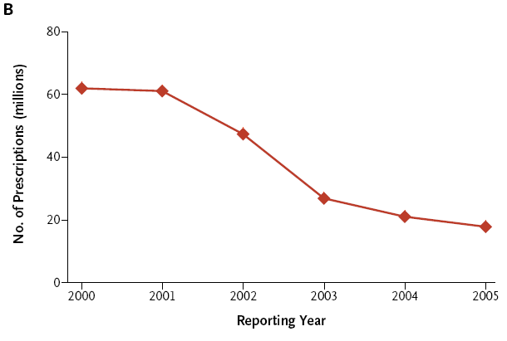
Number of Prescriptions of Menopausal Hormone Therapy in U.S. by Year
Ravdin, et al. N Engl J Med 2007;356:1670

Slide 26
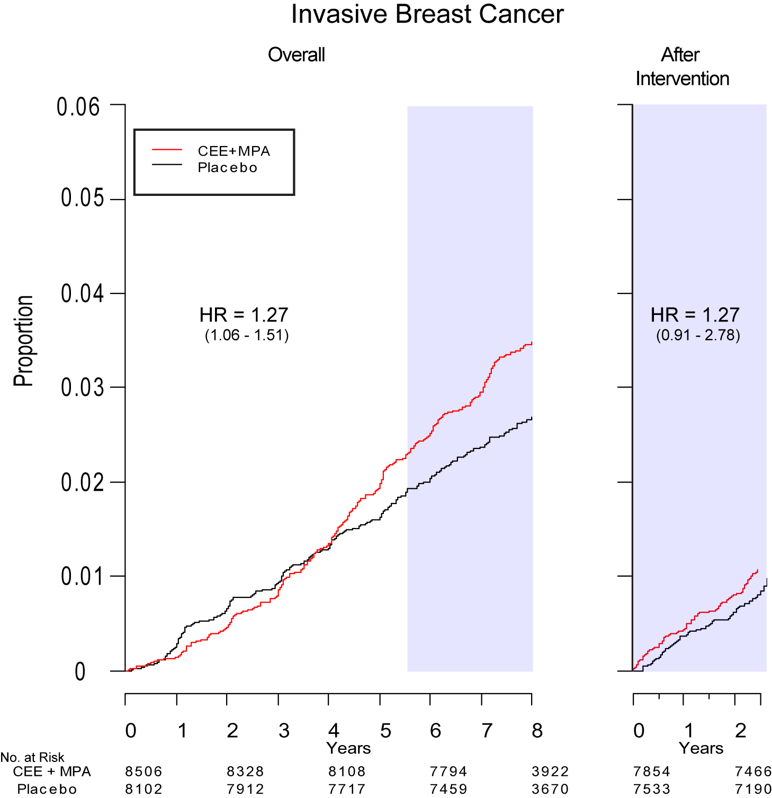
WHI E+P: Post-Interv. Follow-up
Breast Cancer
Heiss et al, JAMA 2008; 299: 1036-1045

Slide 27
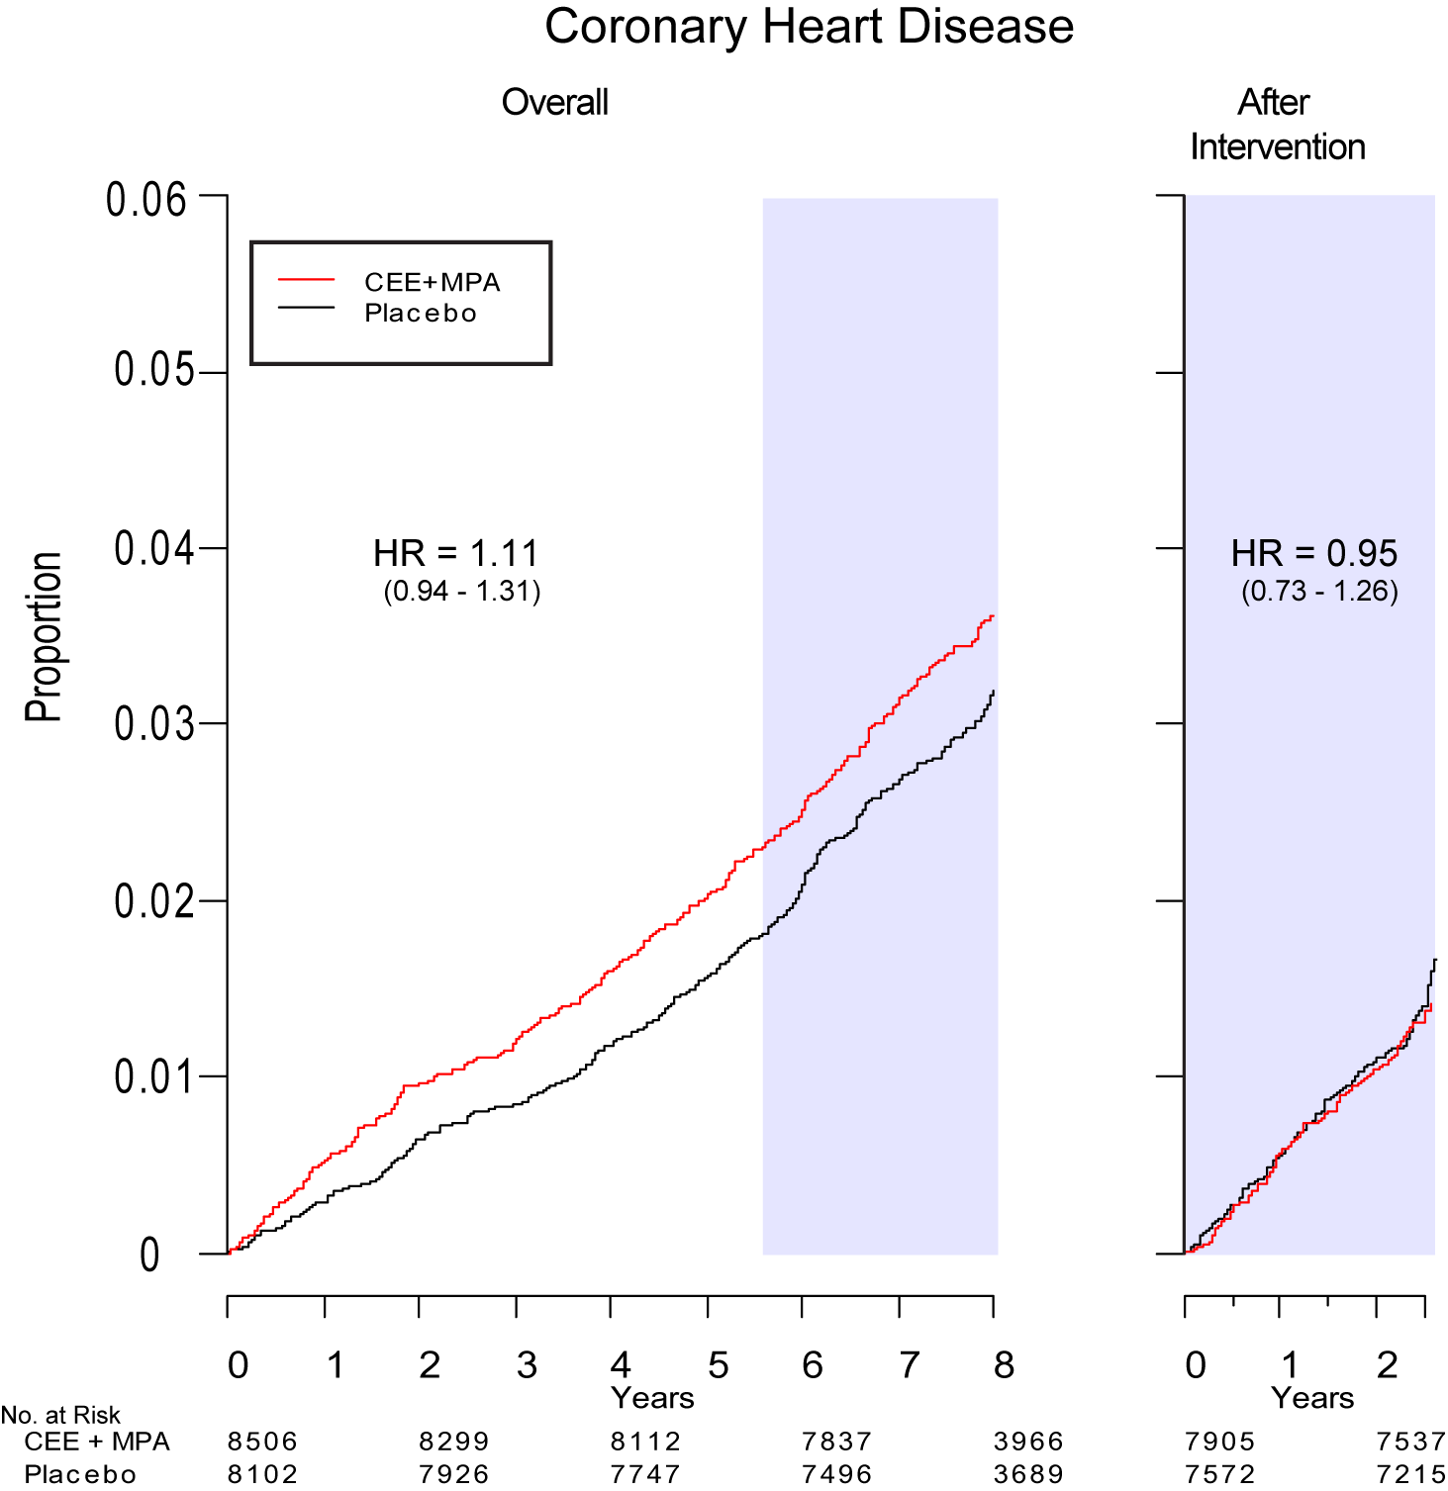
WHI E+P: Post-Intervention Follow-up
CHD
Heiss et al, JAMA 2008; 299: 1036-1045

Slide 28
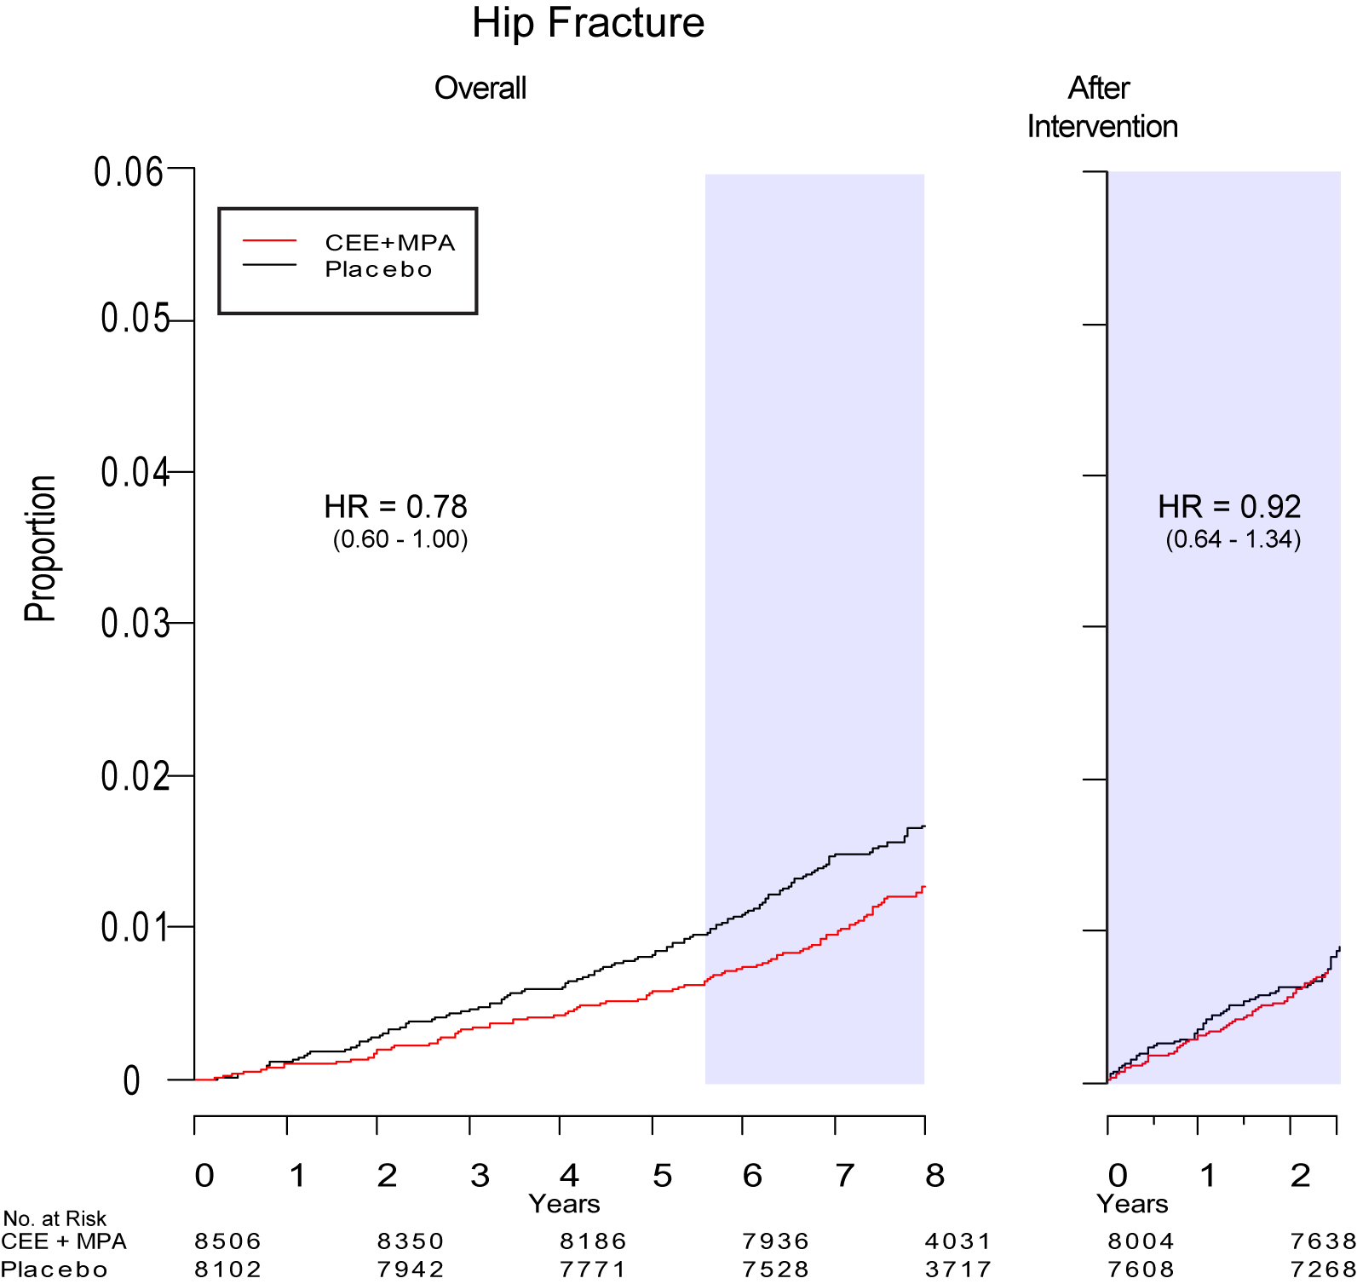
WHI E+P: Post-Interv. Follow-up
HIP Fracture
Heiss et al, JAMA 2008; 299: 1036-1045

Slide 29
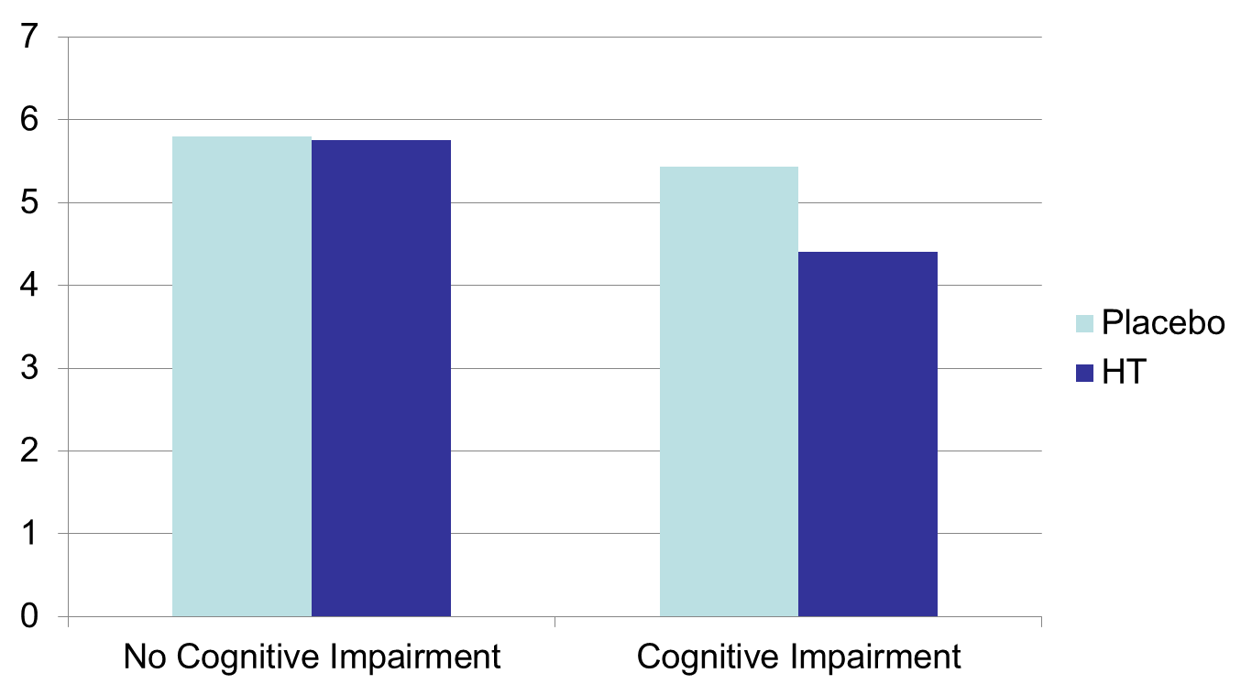
Hippocampus Volumes
Mean Hippocampus Volume (cc)
P<0.001
Espeland MA, et al. J Gerontol A Biol Sci Med Sci. 2009;64:1243-50.

